Slide 1





Bajaj Allianz Life Insurance
iSecure II

Slide 2


Branding
Eligibility Criteria
Boundary conditions
Claim Assurance Certificate
Lowest Premium Guaranteed
Claim Intimation
Cover continuous
Full refund of premium
Health management services
Tax Benefit
Terms and conditions
USP’s

Slide 3

Insurer History & Branding
Bajaj Allianz Life Insurance is a joint venture between Bajaj Finserv Limited (formerly part of Bajaj Auto Limited) owned by the Bajaj Group of India and Allianz SE, a European financial services company based in Germany. Allianz AG [former name of Allianz SE] was founded in Germany, in 1890.
Bajaj Allianz Life Insurance began operations in 2001.
Claim Settlement Ratio: 99.3%
Solvency Ratio: 3.59 (Highest in the industry)
Death Claim Amount paid in FY 23-24: 615 Crores INR

Slide 4





Why we like selling BALIC I-secure II?
12% online discount
1st Year
No income proof required
(Highest Issuance)
2
3
Highly competitive
pricing
2 lakhs on claim intimation (SA >= 50L)
1
4

Slide 5






Who are self-employed?
SMALL BUSINESS OWNERS
ENTREPRENEURS
FREELANCERS
What is their contribution to society?
3 out of 4 people in India are Self employed
CREATE JOBS
FOSTER INNOVATION THROUGH START-UPS
Notes:
~76% of Total employed in 2021
(Source: Self-employed, total (% of total employment) (modeled ILO estimate) in India was reported at 76.12 % in 2021, according to the World Bank collection of development indicators, compiled from officially recognized sources. India - Self-employed; total (% of total employed) - actual values, historical data, forecasts and projections were sourced from the World Bank on October of 2023.)

Slide 6

Boundary Conditions: Annual Income & Education
Ages | Profession | Min Annual Income | Min Education
18 - 50 | Salaried/Self Emp | 2.5 L & above (Upto 1 Cr.) | 10th & Above

Slide 7
Boundary Conditions
KYC Documents | Compulsory
Riders | ADB and ATPD – Optional
Minimum Sum Assured | 25 lacs
Maximum Sum Assured | 1 Cr
Location | Allowed Except - ve Locations
Minimum age of entry | 18 Yrs
Maximum age of entry | 50 Yrs
Minimum Policy Term | 10 Yrs
Maximum Maturity Age | 85 Yrs
Education | 10th Pass
Min Verified income | 2.5 Lacs for Salaried / Self Employed
Nationality Guideline NRI/ Foreign | Student life, retired life not allowed
 | NRI/ Foreign National/ PIO - Not Allowed
Not allowed | Retired Lives,
 | Student Life,
 | Unemployed Profile,
 | Housewife

Slide 8
No income proof required
(Highest Issuance)
Product Features
Boundary Conditions
Minimum Entry Age | 18 years
Maximum Entry Age | 50 years
Minimum Age at Maturity | 28 years
Maximum Age at Maturity | 85 years
Minimum Sum Assured | 25 Lacs
Maximum Sum Assured | 1 Cr.
Policy Term | Policy terms allowed are 10 to (85 less age at entry)
Premium Payment Term | Regular Pay / Limited Pay - 5,10, 15, 20, 25 years
Competitive Premium
Higher “Cover Till Age”
*2 Lac Immediate Payout on Claim Intimation
Flexibility to have a more “PPT Options”

Slide 9
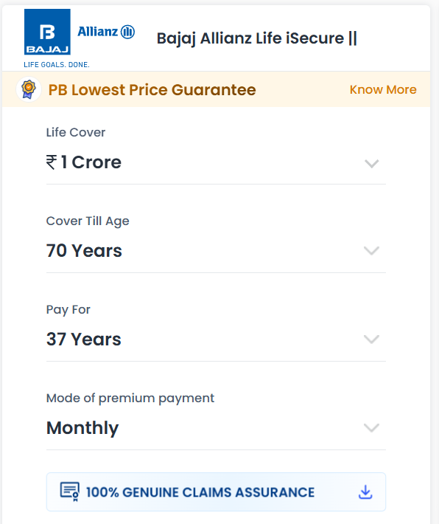
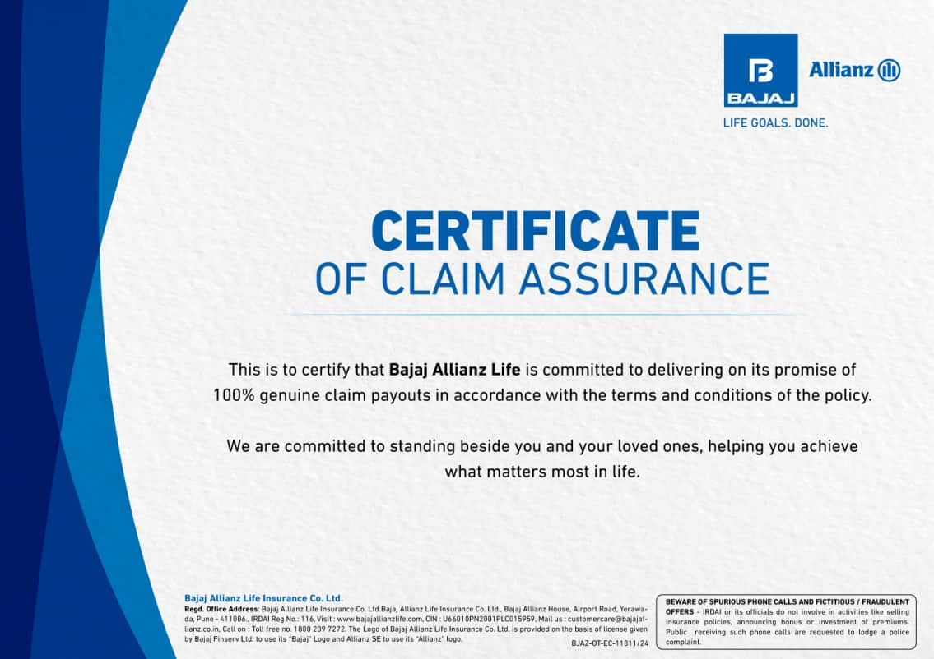
Strong Claim Assurance story: 100% Claims Assurance Certificate

Slide 10

Lowest Price Guarantee Pitch: Certificate Live

Slide 11

Claim Intimation
Conditions: SA - 50L or above After 1st policy term

Slide 12

Cover Continuous Benefit – Option to Delay 12 months Premium: (In-built, Free)

Slide 13

Full refund of premium and premium holiday feature
Full refund of premium
PT >=35 (min. 70),
Exit between 60-64
Auto cover continuance benefit;
Option to delay 12 months premium

Slide 14

Full Refund of Premium
“Sir , with this benefit , you can protect your family & also Exit the policy or end the policy if your all responsibility has been over and get your Paid Premiums Back ( without the GST & Loading Premiums).
This implies that the plan served the purpose when you needed it for Family Protection . And when you don’t need it anymore, you can exit it by getting your paid premium back, making it a ZERO-COST Plan”

Slide 15

Full Refund of Premium
Conditions:
1. Age at entry <= 50 years 2. Policy Term >= 35 years 3. Maturity Age>= 70 years
During 5 policy years immediately after attaining Age 60
Customer can take exit to 60-64 which means have 5 years of window to take exit.
Note: (Total Premiums Paid – (GST, Riders’ Premium, Loading Premium) = Remainder Premium is refunded at the time of exit.

Slide 16
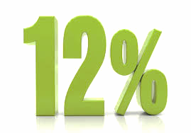
Online Discount
Discount Parameters | Salaried | Self Employed
On 1st Year Premium Salaried Discount | 12% Discount for 1st Year Premium | 12% Discount for 1st Year Premium
Total Discount | 12% for salaried | 12% for self employed

Slide 17



Higher Cover till Age : Upto 85 Years
Convenient and Nimble sales process.
Competitive and Affordable premium.
“Easy & Affordable Plan”
“Self-Employed Segment” -
Income Proof waiver facility is available*.
*Based on Profile

Slide 18
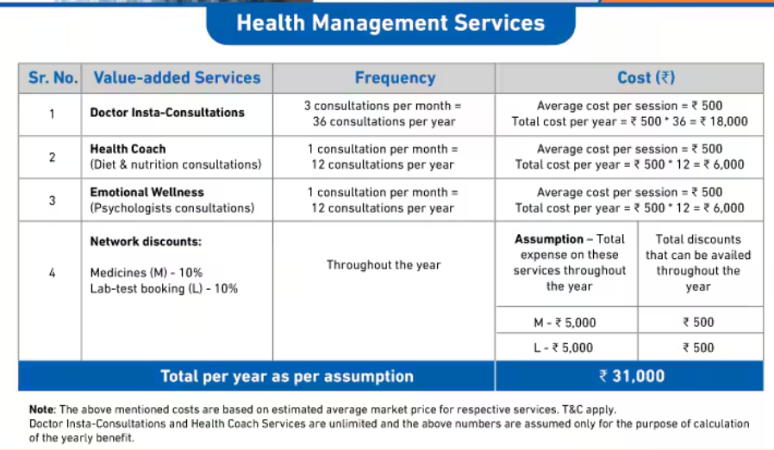
Health Management Service for Male Customer

Slide 19

Health Management Service for Women customer

Slide 20
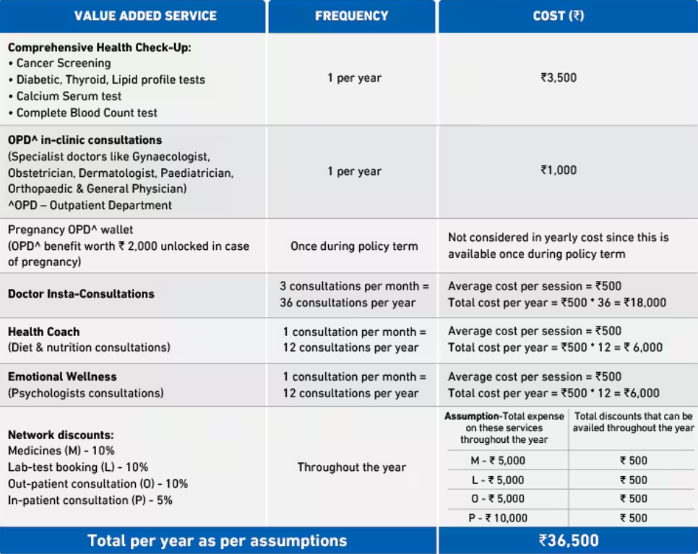
Health Management Service for Women customer

Slide 21
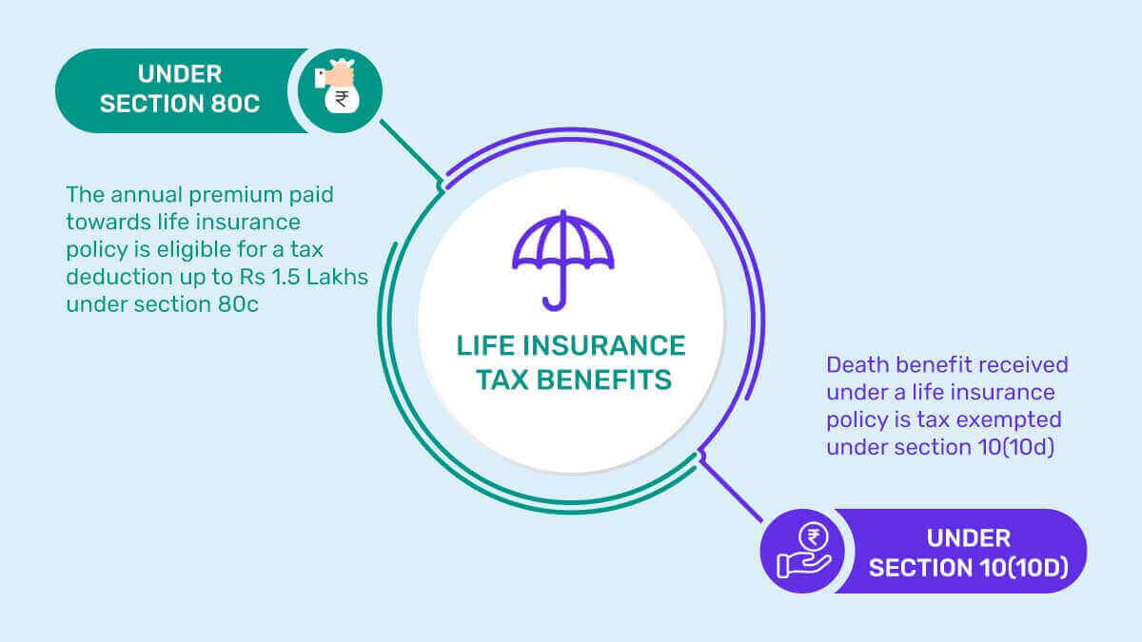
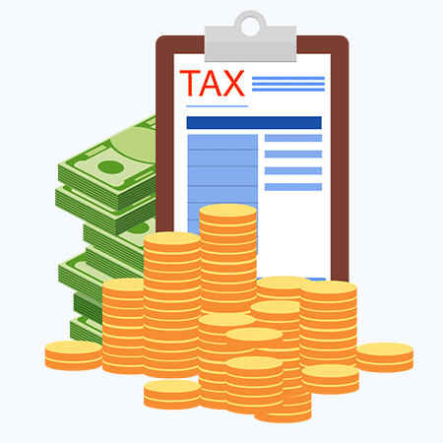
Taxation

Slide 22
Terms and Conditions
Free Look Option | 30 days from the day customer receives the policy document/bond
Grace Period | 30 days in case of Y/H/Q frequencies & 15 days in case of M frequencies from the premium due date
Reinstatement/Revival Period | 5 Years from the due date of the first unpaid premium and before the termination date of policy

Slide 23



